Slide 1

IBM Data Science Capstone Project
Predict the Accident severity for vehicle GPS

Slide 2
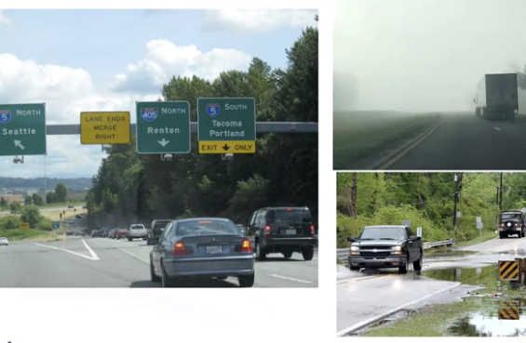
Introduction
Increasing demand for GPS navigation
GPS to predict accident severity and find safest route
Use machine learning to build prediction model

Slide 3
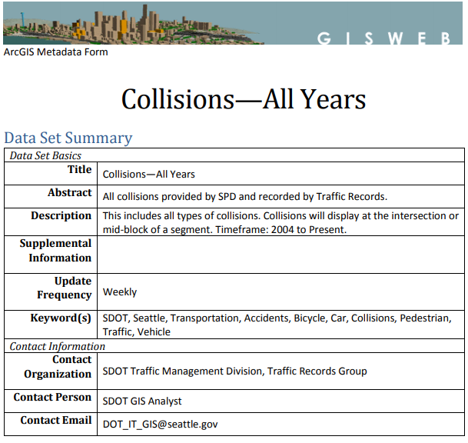
Data
Collision data in Seattle
Target: Severity code
Independent: Location, road condition, weather, junction type, etc.

Slide 4
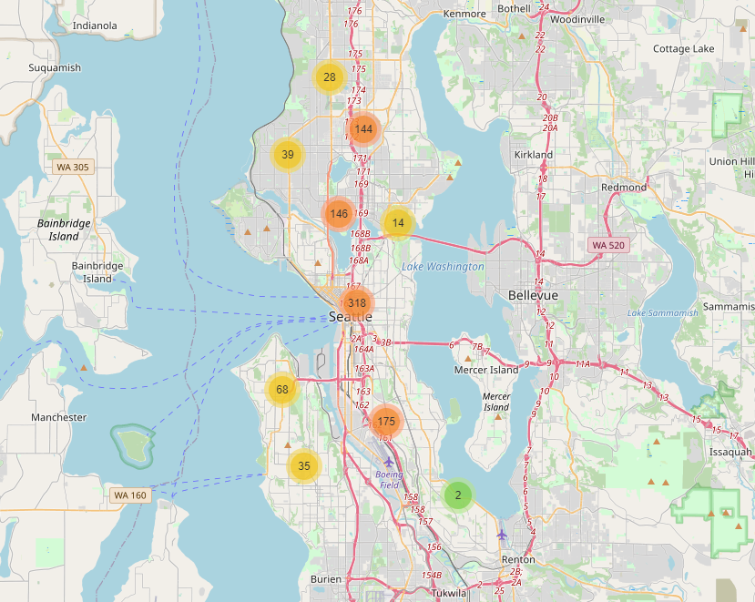
Data Seattle collisions
Frequent collisions along the highway

Slide 5
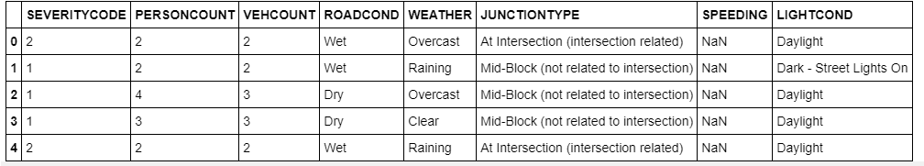
Methodology Dataset preparation

Slide 6
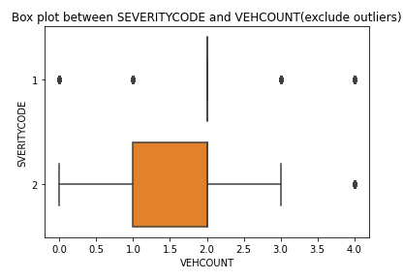
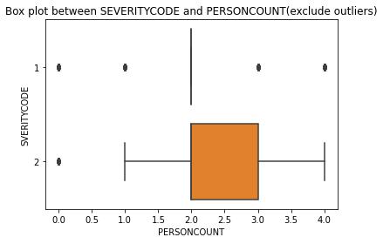
Methodology Data analysis
Analysis numerical independent variables: vehicle count, person count

Slide 7
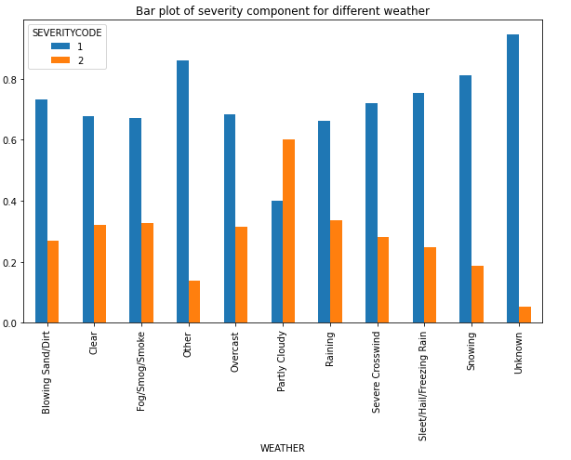
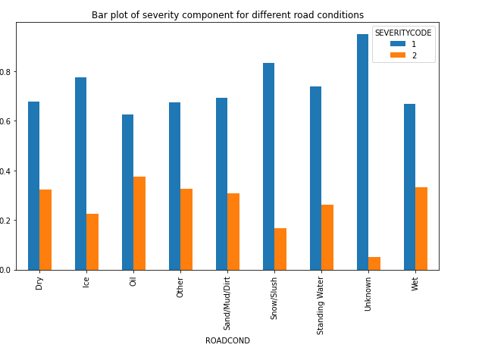
Methodology Data analysis
Deal with categorical variables

Slide 8
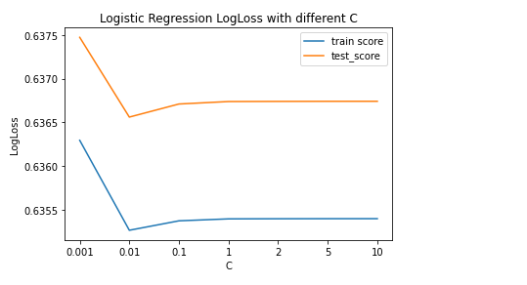
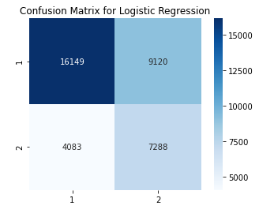
Model and Evaluation Logistic Regression

Slide 9
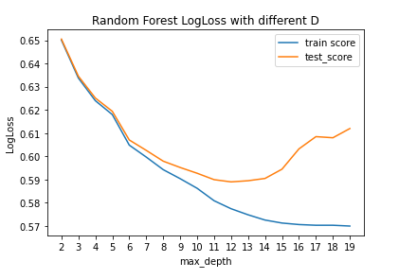
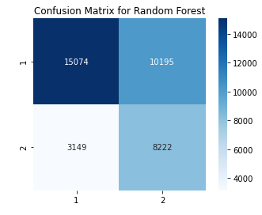
Model and Evaluation Random Forest

Slide 10
Conclusion
Developed machine learning models to predict the accident severity and the corresponding possibility
More potentials to be explored further
Consider weights on type II errors

